Slide 1
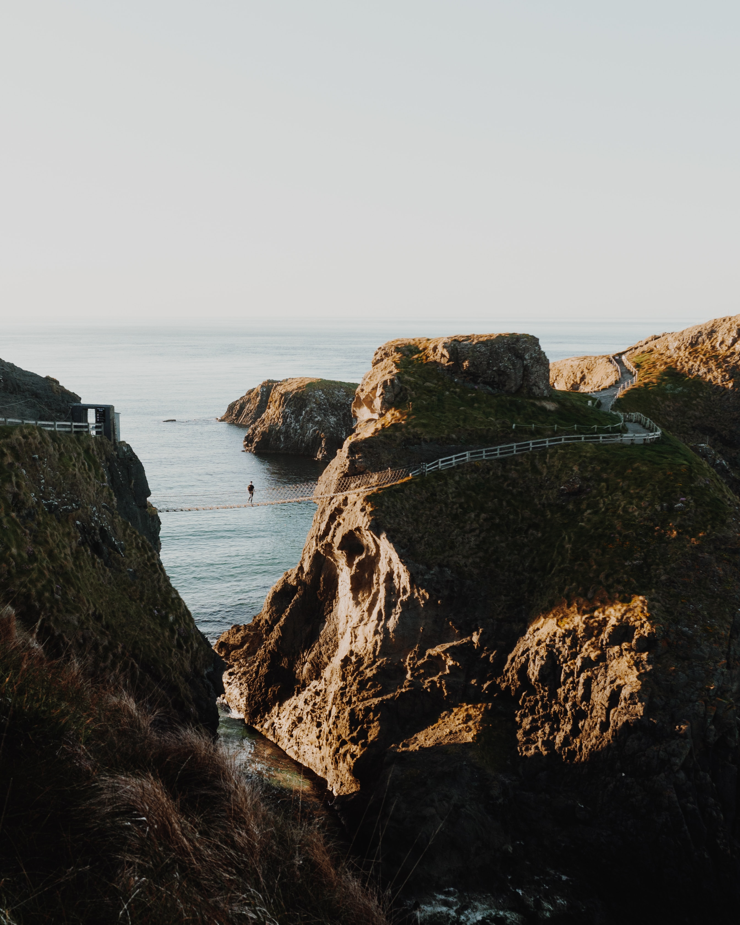
GOOD NEWS
REVIVAL
[Nehemiah 8:1-18]

Slide 2
REVIVAL CAME BECAUSE GOD’S WORD WAS READ,
HEARD, RESPONDED TO
AND OBEYED

Slide 3
1. TO SEE REVIVAL,
GOD’S PEOPLE
MUST READ
HIS WORD

Slide 4
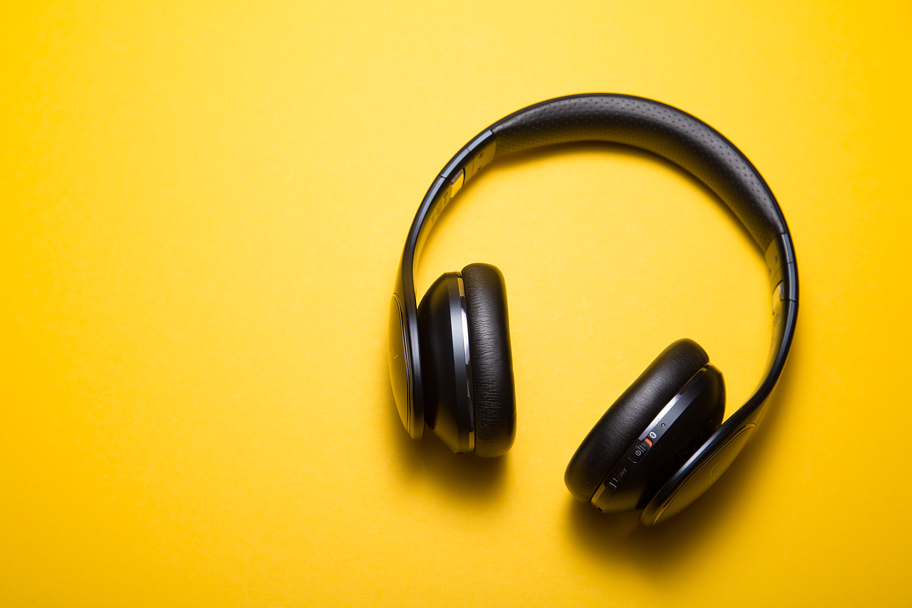
2. TO SEE REVIVAL,
GOD’S PEOPLE
MUST HEAR
HIS WORD

Slide 5
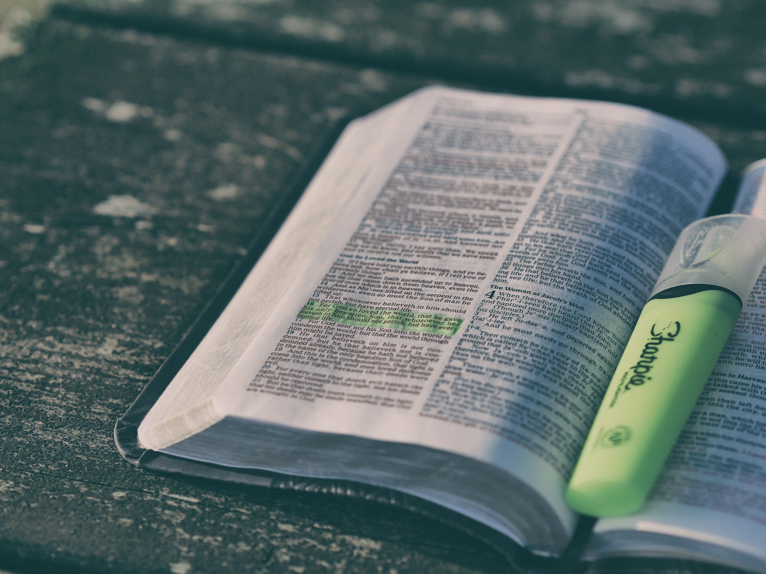
3. TO SEE REVIVAL,
GOD’S PEOPLE
MUST STUDY
HIS WORD

Slide 6
IF WE WANT TO SEE
REVIVAL, WE MUST
RESPOND AND OBEY

Slide 7
WILL YOU RESPOND?
repentance joy good deeds obedience worship

